Slide 1
Tata Letak Sensor Rumpiang
Total : 76 Sensor

Slide 2
ATRH
Displacement
Anemometer
Thermistor
Seismometer
Strain Gauge
Inclinometer
Vibrometer

Slide 3
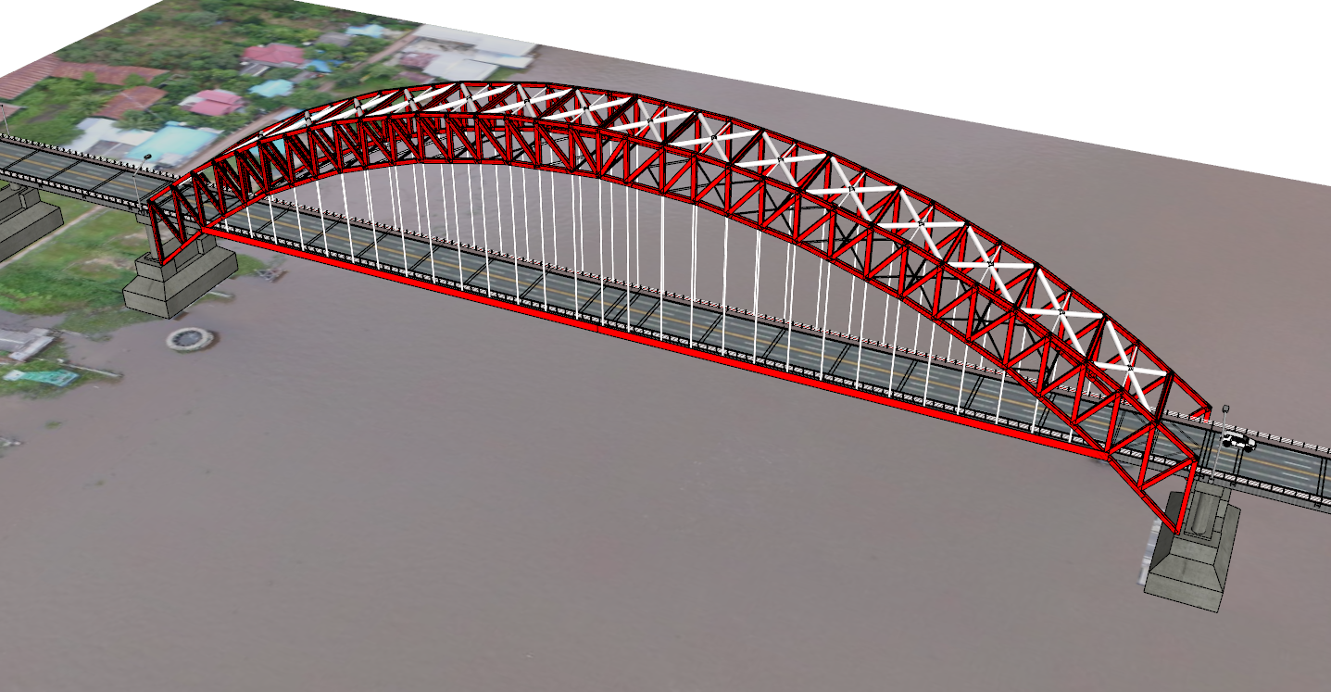
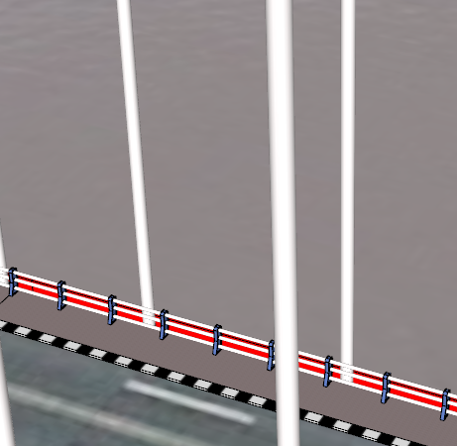
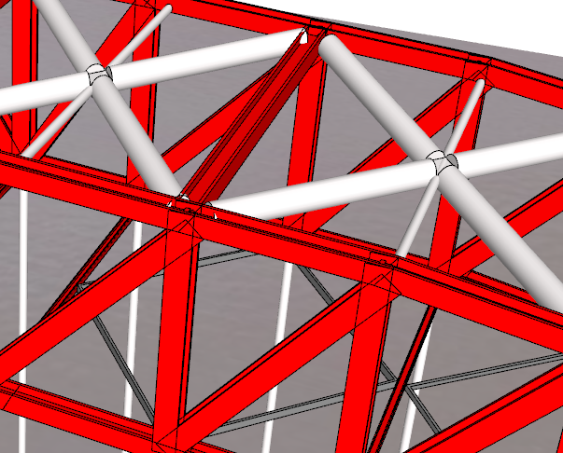
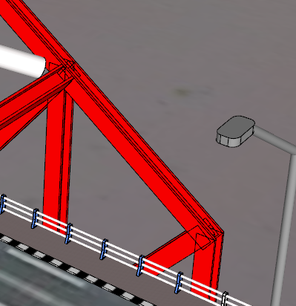
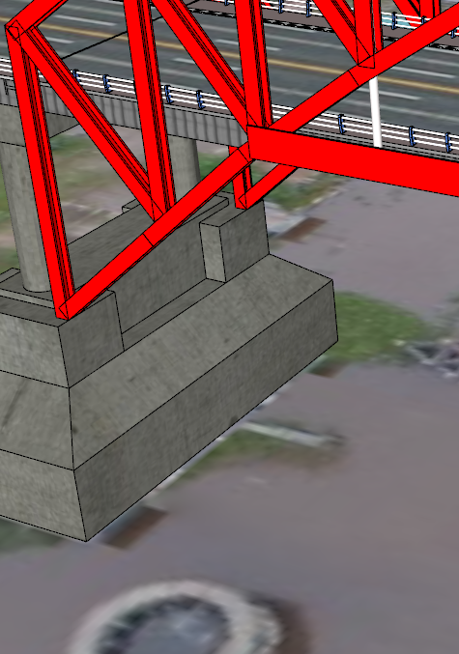
Environtment

Slide 4
Environtment
2
4
1
1
3
2
4
3

Slide 5
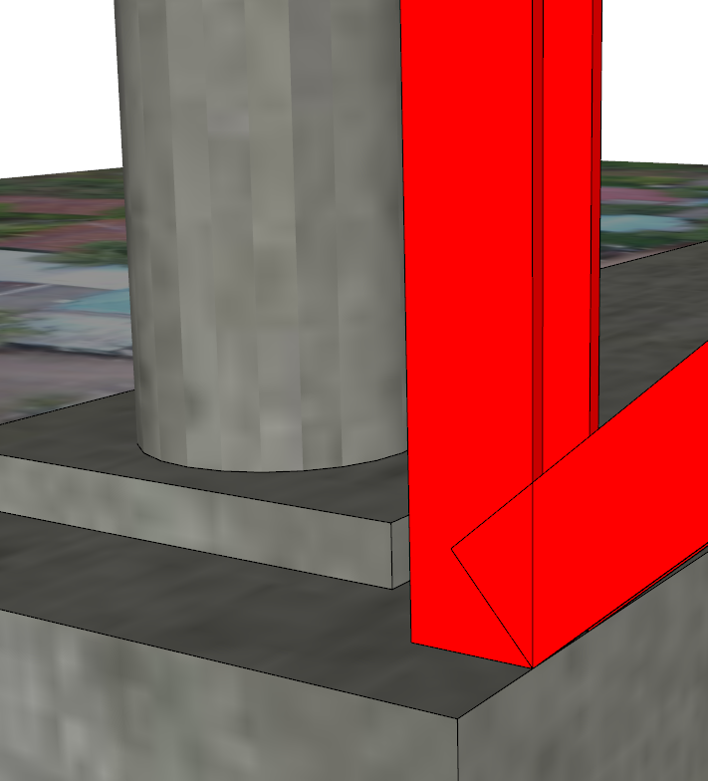
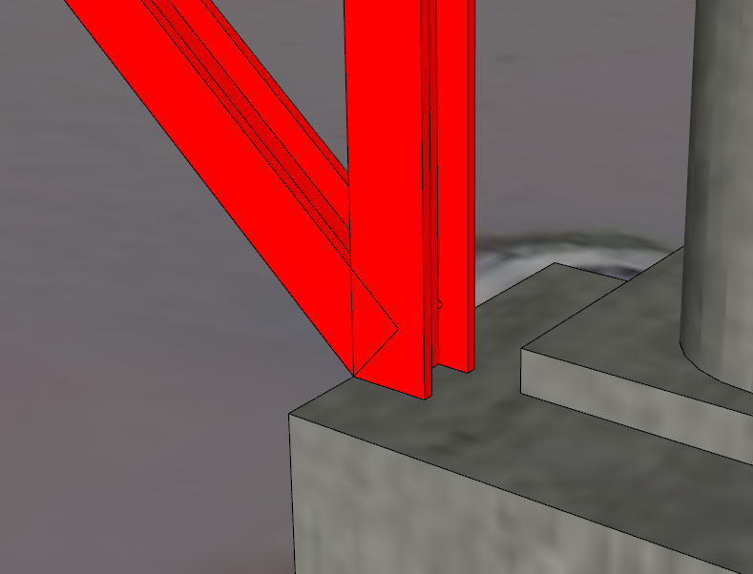
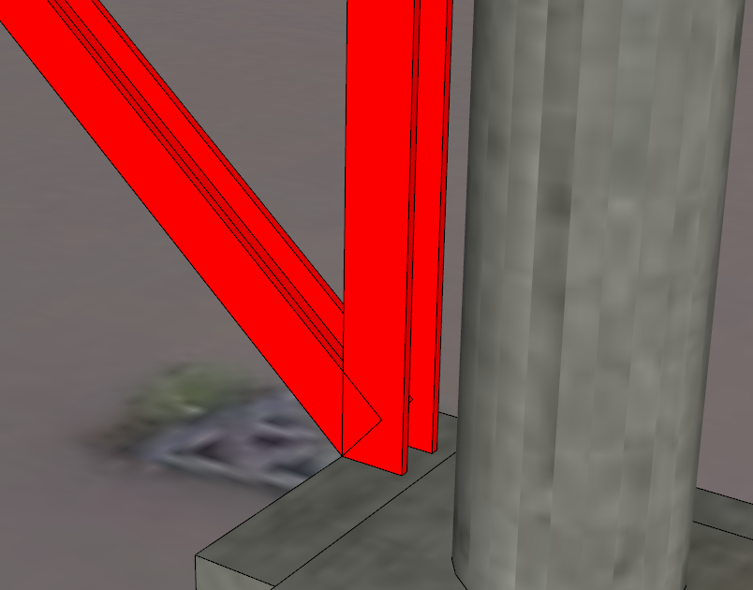
Linear_Displacement

Slide 6
Linear_Displacement
1
2
3
4
2
1
3
4

Slide 7
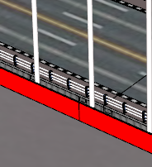
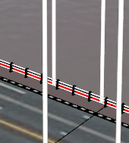
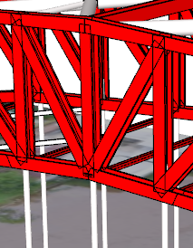
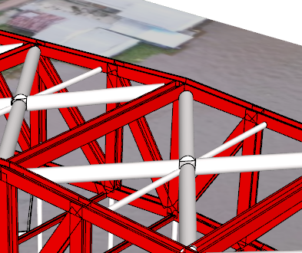
Anemometer

Slide 8
Anemometer
4
3
2
1
3
4
1
2

Slide 9
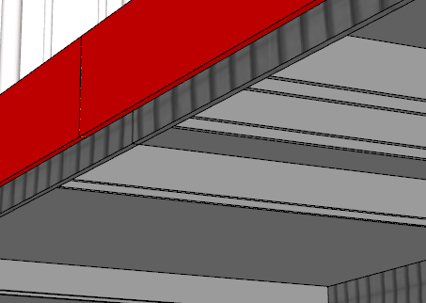
Thermistor

Slide 10
Thermistor
2
1
2
1

Slide 11
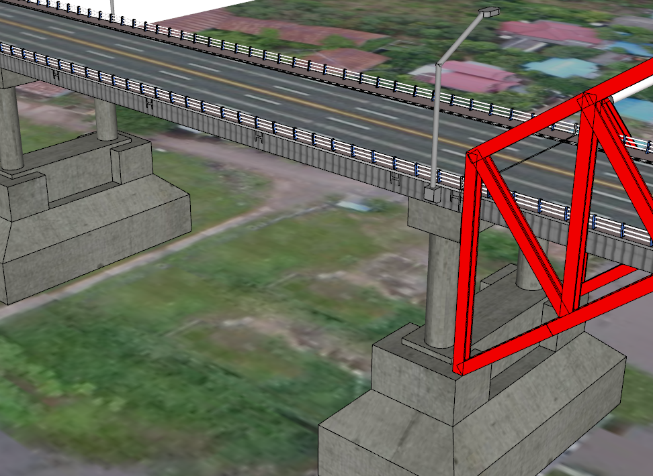
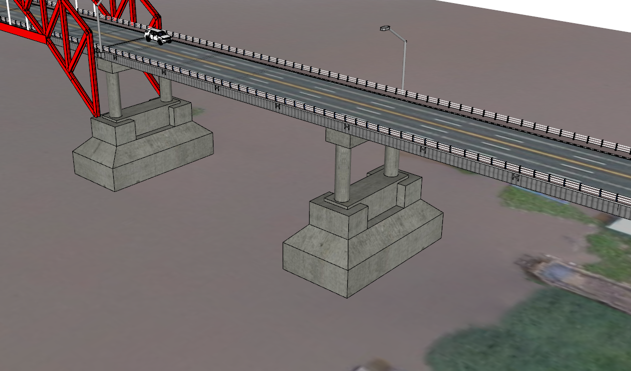
Seismometer

Slide 12
Seismometer
1
2
1
2

Slide 13
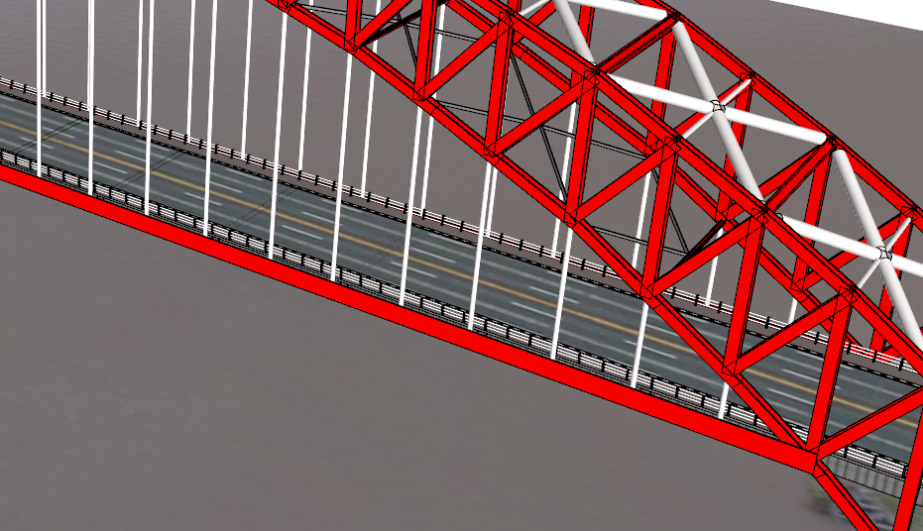
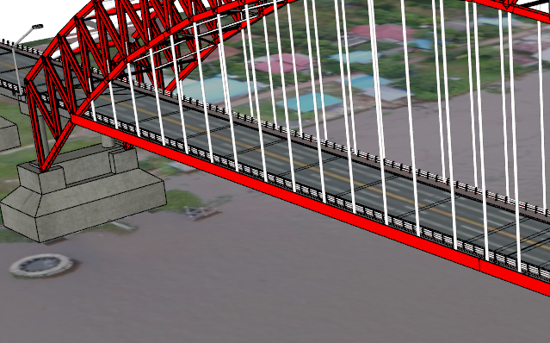

Strain_Gauge_Frame

Slide 14
Strain_Gauge_Frame
1
2
1
3
2
4

Slide 15
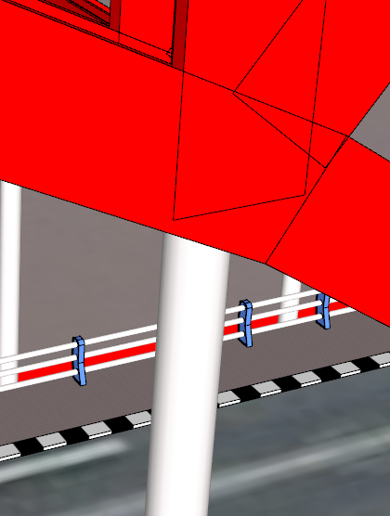
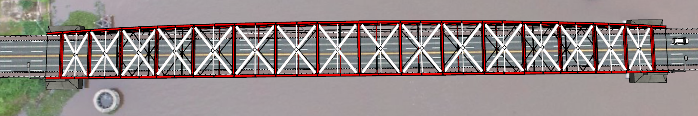
Strain_Gauge_Hanger

Slide 16

Strain_Gauge_Hanger
2
11
3
12
4
5
1
10
9
8
7
6

Slide 17
Horizontal_Inclinometer

Slide 18
Horizontal_Inclinometer
7
8
1
2
3
4
5
6

Slide 19
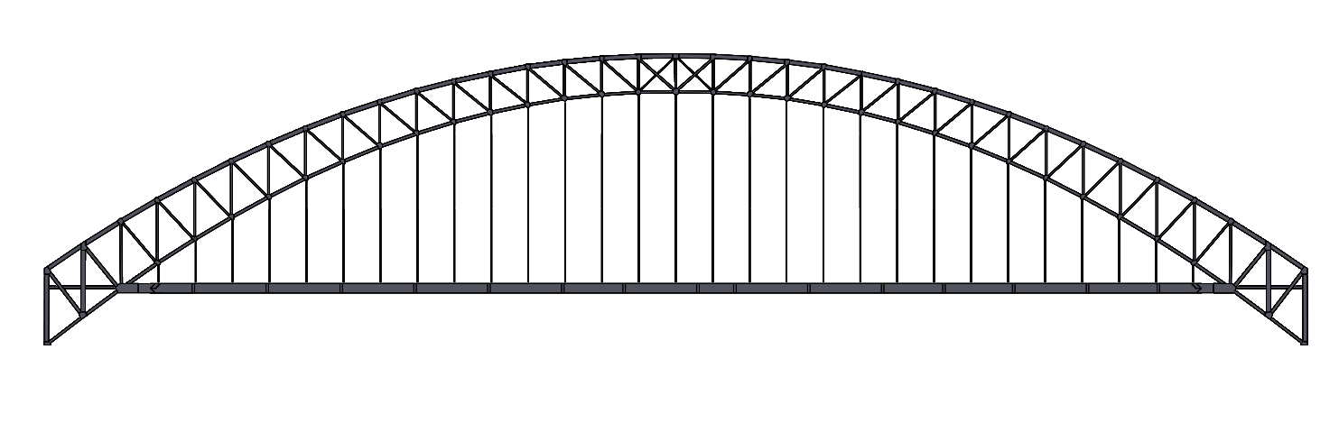
Vertical_Inclinometer

Slide 20
Vertical_Inclinometer
1
2
3
4

Slide 21
Vibrometer_Hanger

Slide 22
Vibrometer_Hanger
4
5
6
7
3
8
2
1
16
15
14
13
12
11
10
9

Slide 23
Vibrometer_Frame

Slide 24
Vibrometer_Frame
1
2
3
4
5
6
7
8
16
15
14
13
12
11
10
9

Slide 25
Nomenklatur Girder

Slide 26
Nomenklatur Girder
Marabahan
Banjarmasin
Left
G1G2
G3
G4
G5
G6
Right
S1
S35
S1,S2,S3,……,S35

Slide 27
Nomenklatur Hanger

Slide 28
Nomenklatur Hanger
Marabahan
Banjarmasin
H1
H29
H1,H2,H3,……,H29

